Slide 1

Darkweb For Fun & Profit
wehackpeople.com

Slide 2


Hackers!!!

Slide 3


Slide 4


Slide 5
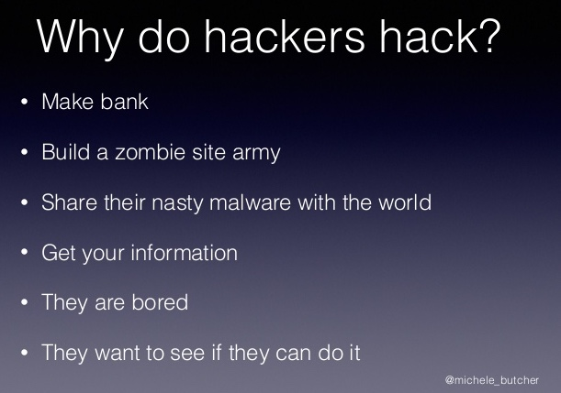

Slide 6


Slide 8


Slide 9


Slide 10
Questions?

